Slide 1
Applet Programming
Applet is a small Java program used for Internet computing
It runs over the Internet using a web browser or on AppletViewer
Local applet: Developed locally and stored locally
Remote applet: Developed by someone else & stored on remote system connected to the Internet
Download it onto your system via the Internet(using its URL) and run it

Slide 2
Applets vs Applications
Applications are standalone & can be full-fledged java programs. Applet is not a full-fledge program, they can handle only a task at hand.
Applets do not have main() methods. Instead, when an applet is loaded, it calls certain methods of Applet class to start and execute the applet code.
Stand alone applications can run independently. Applet runs from within the browser using the HTML’s <applet> tag
Applet cannot read from or write to files in the local computer
Applets cannot communicate with other servers

Slide 3
Applets cannot run any other program or access any resource from the local system
Applets cannot use libraries of the programming languages. Applications can use them through native methods

Slide 4
Steps in building Applets
Build the .java file
Create the .class file
Design a web page using <HTML> tag
Prepare the <APPLET> tag
Incorporate the <APPLET> tag into the web page
Create the .html file
Test the applet code over the browser or appletviewer

Slide 5
Building applet code
Applet code requires two classes:
Applet and Graphics
Applet class is in java.applet package. We require methods like init(), start(), paint(), etc. called by Java when an applet loads
init(): to create objects required by the applet and set initial values.
start(): applet enters the running state when start() gets called. Perform any processing.
paint(): to display the result of applet code on screen.

Slide 6
stop(): it is automatically called when the user moves from the page containing an applet
destroy(): called when the browser shuts down normally.
Thus, any applet can be initialized once, started and stopped one or more times and gets destroyed once.
It is simply NOT compulsory that every applet overrides all of these methods

Slide 7
paint() method
paint() method requires Graphics object as argument
Graphics class is in java.awt package
Hence, it should be imported before using its object.
All the output operations of an applet are performed from within the paint() method using methods defined in Graphics class

Slide 8
General Applet Skeleton
import java.applet.*;
import java.awt.*;
public class MyApplet extends Applet
{
public void init()
{ // called first, initializations
}
public void start()
{ // code to start or resume execution
}
public void stop()
{ // code for suspension
}
public void destroy()
{ // code to execute while the applet is unloaded from memory
}
public void paint(Graphics g)
{ // code to display
g.drawString(“message to display” ,x , y);
}
}

Slide 9
First applet
import java.applet.*;
import java.awt.*;
public class MyFirstApplet extends Applet
{
public void paint(Graphics g)
{
g. drawString(“Hello”, 10,100);
}
}

Slide 10
Creating the required web page
<html>
<Head>
<title>……………</title>
</head>
<body>
:
<applet></applet>
:
:
</body>
</html>

Slide 11
Preparing the <applet> tag
<applet code=“NewApplet.class”
width= “400”
height=“200”>
</applet>

Slide 12
Encorporate the <APPLET> tag into the web page
<html>
<body>
<applet code=“NewApplet.class” width= “400” height=“200”>
</applet>
</body>
</html>

Slide 13
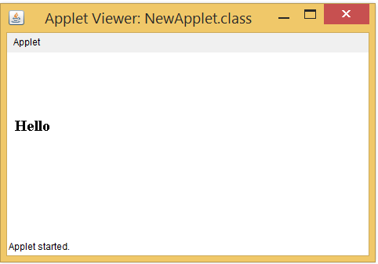
How to compile and run Applet
Compile the Java applet code(.java file) as:
javac NewApplet.java
Run the applet as:
appletviewer MyApplet.html

Slide 14
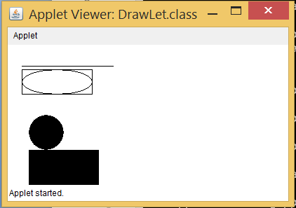
Applet to draw shapes
import java.applet.*;
import java.awt.*;
public class DrawLet extends Applet
{
public void paint(Graphics g)
{
g.drawLine(20,30,150,30);
g.drawRect(20,35,100,35);
g.drawOval(20,35,100,35);
g.fillRect(30,150,100,50);
g.fillOval(30,100,50,50);
}
}

Slide 15
Passing Parameters to Applets
We can pass parameters from the HTML code to the Applet code using the <PARAM> tag
<html>
<body>
<applet code=NewApplet.class width= 400 height=200>
<Param name=“str” value=“Java”>
</applet>
</body>
</html>

Slide 16
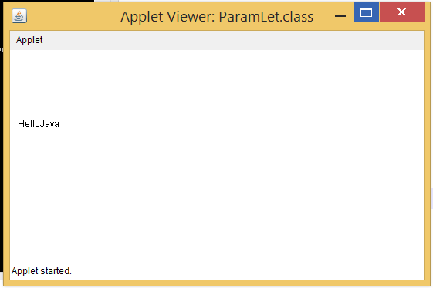
import java.applet.*;
import java.awt.*;
public class NewApplet extends Applet
{
String s;
public void init()
{
s= getParameter(“str”);
s=“Hello”+s;
}
public void paint(Graphics g)
{
g. drawString(s,10,100);
}
}

Slide 17
How to interact with user?
Classes from java.awt like TextField, Button, Label,…etc. can be used to interact with the user
Step to build interactive applet:
In init():
create objects for all the components
initialize the object
add them to the display area ( i.e. container)
2. In the paint() method, perform operations on the given data and display the output

Slide 18
import java.applet.*;
import java.awt.*;
public class UserLet extends Applet
{
TextField t1,t2;
Label l1,l2;
public void init()
{
t1=new TextField(8);
t2=new TextField(8);
l1=new Label(“Number 1”);
l2=new Label(“Number 2”);
add(l1);
add(t1);
add(l2);
add(t2);
setBackground(Color.yellow);
}

Slide 19
public void start()
{
String s1,s2,s3;
int x,y,z;
s1=t1.getText();
s2=t2.getText();
x=Integer.parseInt(s1);
y=Integer.parseInt(s2);
z=x+y;
s3=String.valueOf(z);
}
public void paint(Graphics g)
{
g.drawString(“The Sum is:” ,10, 100);
g.drawString(s3, 20, 100);
}
public boolean action(Event e, Object o)
{
repaint();
return true;
}
}

Slide 20
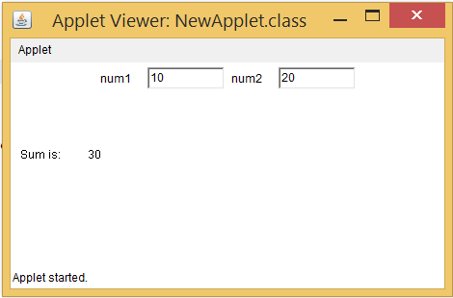

Slide 21
Repainting Request
An applet writes to a window only when paint() method is called.
But the what when the applet needs to redraw something?, may be based on users interaction
repaint() method is called when the information displayed in applet window has to be updated
When repaint() method is called, the runtime system internally calls the update() method for applet
The update() method by default calls the paint() method again

Slide 22
The data to be displayed when repaint() is called can be stored in a String variable and can be printed by calling the drawString() method from the paint() method
Ways to call repaint():
void repaint(): //Entire window is updated
void repaint(int left, int top, int width, int height) // specified pixels are repainted
void repaint(long max_delay) // repaint comes into effect after specified time delay

Slide 23
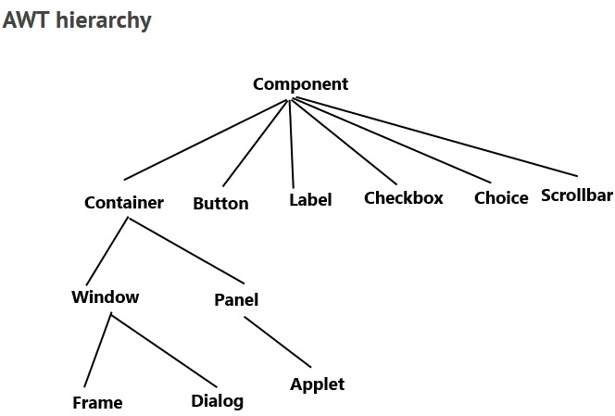
Can we create standalone GUI applications in Java ??

Slide 24
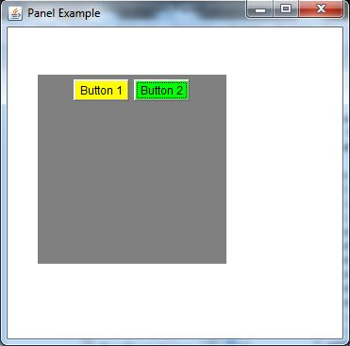
AWT Programming for Frame
Java AWT Panel Example

Slide 25
Event Handling in Java
Event handling in Java can either be general event handling (i.e. not specific to any component)
GUI Event Handling
OR
Event handling can be specific to any component

Slide 26
Event is an object representing the occurred event
Event Source is an object that generates the event
Any Source (eg. textfield, button, key, mouse, etc.) can generate more than one events
A source has to register with an event listener
The appropriate Event Listeners are notified when an event occurs
Any Event Listener must be registered with one or more sources and it must implement some method for receiving & processing that event’s notification
public void addTypeListener(TypeListener e)

Slide 27
Let's assume an Invigilator is monitoring his/her students
Invigilator will keeps monitoring his students (which means he has started to observe them waiting for an Event to happen, this is what an ActionListener does).
If the Invigilator catches a students cheating, he will take action to the event (ActionEvent)

Slide 28
ActionEvent: generated when a button is pressed, a list item is double-clicked or a menu item is selected
AdjustmentEvent: when scroll bar is manipulated
ItemEvent: when a check box or item list is clicked
MouseEvent: when a mouse is dragged, moved, clicked, pressed or released
TextEvent: when the value of a TextField or TextArea is changed
KeyEvent: when input is received from the keyboard

Slide 29
ActionListener : this interface has an actionPerformed() method that is invoked when an action event occurs.
AdjustmentListener
AdjustmentListener
ItemListener
MouseListener
TextListener
KeyListener

Slide 30
ActionListener Example

Slide 31
The MouseListener Interface
The Java MouseListener is notified whenever you change the state of mouse.
It is notified against MouseEvent.
The MouseListener interface is found in java.awt.event package.
It has five methods:
public abstract void mouseClicked(MouseEvent e);
public abstract void mouseEntered(MouseEvent e);
public abstract void mouseExited(MouseEvent e);
public abstract void mousePressed(MouseEvent e);
public abstract void mouseReleased(MouseEvent e);

Slide 32
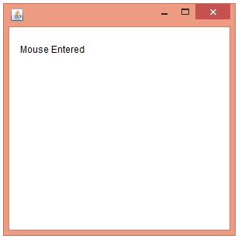
MouseListenerExample

Slide 33
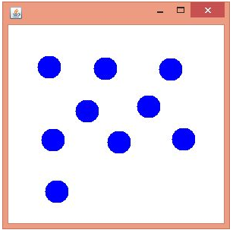
MouseListener to print Blue Dots with clicked inside the frame

Slide 34
The MouseMotionListener Interface
The Java MouseMotionListener is notified whenever you move or drag mouse.
It has two methods:
public abstract void mouseDragged(MouseEvent e);
public abstract void mouseMoved(MouseEvent e);

Slide 35
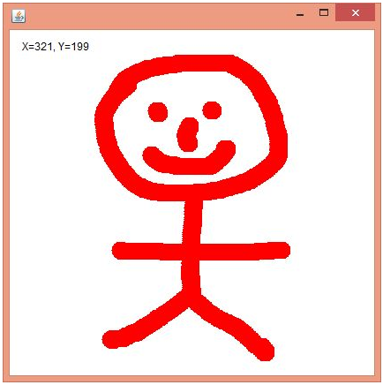
MouseMotionListener Example

Slide 36
KeyListener Interface
The Java KeyListener is notified whenever you change the state of any key.
It is notified against KeyEvent.
It has three methods:
public abstract void keyPressed(KeyEvent e);
public abstract void keyReleased(KeyEvent e);
public abstract void keyTyped(KeyEvent e);
Constants of KeyEvent class:
KeyEvent.VK_LEFT KeyEvent.VK_PAGE_UP
KeyEvent.VK_UP KeyEvent.VK_F2 …..etc.

Slide 37
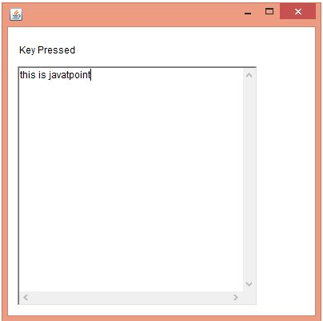
KeyListener Example

Slide 38
Transition: AWT to Swing
AWT supports limited graphical Interface (those which are supported by the underlying O.S.)
Thus, AWT the look & feel of a component is defined by the platform, not by Java
The AWT classes use the native code to present any component, hence are heavyweight
Heavyweight components induce many restrictions such as rectangular and opaque appearance

Slide 39
So is AWT obsolete ??
Swing does not replace AWT, but it is built on the AWT
All other mechanisms such as event handling still remain the same in Swing as well
Swing has just separated the look & feel of any component from the logic of that component
This is to make the component’s look & feel customizable (which remains same across platforms), while keeping the functionality the same.

Slide 40
Java LayoutManagers
The LayoutManagers are used to arrange components in a particular manner.
java.awt.BorderLayout
java.awt.FlowLayout
java.awt.GridLayout
java.awt.CardLayout
java.awt.GridBagLayout
javax.swing.BoxLayout
javax.swing.GroupLayout
javax.swing.ScrollPaneLayout
javax.swing.SpringLayout

Slide 41
BorderLayout
The BorderLayout is used to arrange the components in five regions: north, south, east, west and center.
Each region (area) may contain one component only.
public static final int NORTH
public static final int SOUTH
public static final int EAST
public static final int WEST
public static final int CENTER

Slide 42
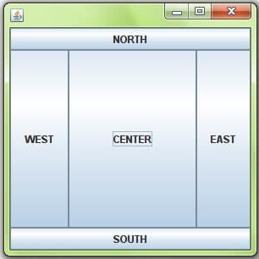
BorderLayout Example

Slide 43
GridLayout
The GridLayout is used to arrange the components in rectangular grid.
One component is displayed in each rectangle.
Constructors of GridLayout class:
GridLayout(): creates a grid layout with one column per component in a row.
GridLayout(int rows, int columns): creates a grid layout with the given rows and columns but no gaps between the components.
GridLayout(int rows, int columns, int hgap, int vgap): creates a grid layout with the given rows and columns alongwith given horizontal and vertical gaps.

Slide 44
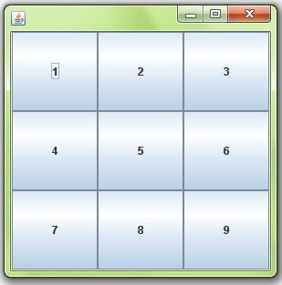
MyGridLayout Example

Slide 45
FlowLayout
The FlowLayout is used to arrange the components in a line, one after another (in a flow).
It is the default layout of applet or panel.
Constructors of FlowLayout class:
FlowLayout(): creates a flow layout with centered alignment and a default 5 unit horizontal and vertical gap.
FlowLayout(int align): creates a flow layout with the given alignment (RIGHT,LEFT,CENTER, etc.) and a default 5 unit horizontal and vertical gap.
FlowLayout(int align, int hgap, int vgap): creates a flow layout with the given alignment and the given horizontal and vertical gap.

Slide 46
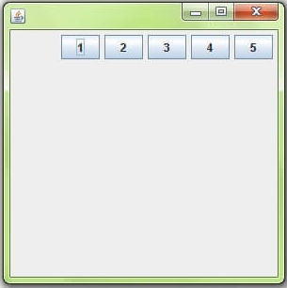
MyFlowLayout Example

Slide 47
BoxLayout
The BoxLayout is used to arrange the components either vertically or horizontally.
For this purpose, BoxLayout provides constants like:
public static final int X_AXIS
public static final int Y_AXIS
Constructor of BoxLayout class:
BoxLayout(Container c, int axis): creates a box layout that arranges the components with the given axis in the specified container ‘c’

Slide 48
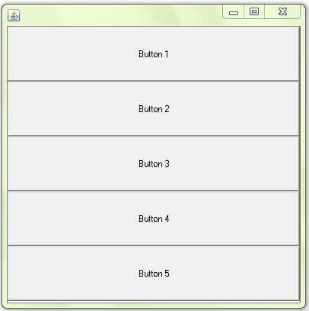
BoxLayoutExample1

Slide 49
What about Event Handling in Applets…??
We can use event handling for applets in the same way (as that for frames or panel) just by extending from the Applet class instead of (Frame/ JFrame/ Panel/ JPanel)
class MyInteractiveApplet extends Applet implements TypeListener
{
:
:
}

